Slide 1

Pleasant Valley Recreation and Park District
2024 Adult Basketball Managers Meeting
February 7, 2024 6pm
Zoom Meeting
Nicholas Castro, Recreation Specialist

Slide 2
Announcements:
Spring 2024 Registration Dates & Fees
League Play Begins: Monday, March 18th
Early Registration: Monday, February 21st- Friday, March 1st
Early Registration Fee: $295 per team
Late Registration: Saturday, March 2nd – Wednesday, March 6th
Late Registration Fee: $320 per team
Officials Fee: $35 per team per game
Basketball Forms, Schedules, & Free Agency at www.pvrpd.org
Team Managers – Register through our new online reservation system, Amilia, found on our website!

Slide 3
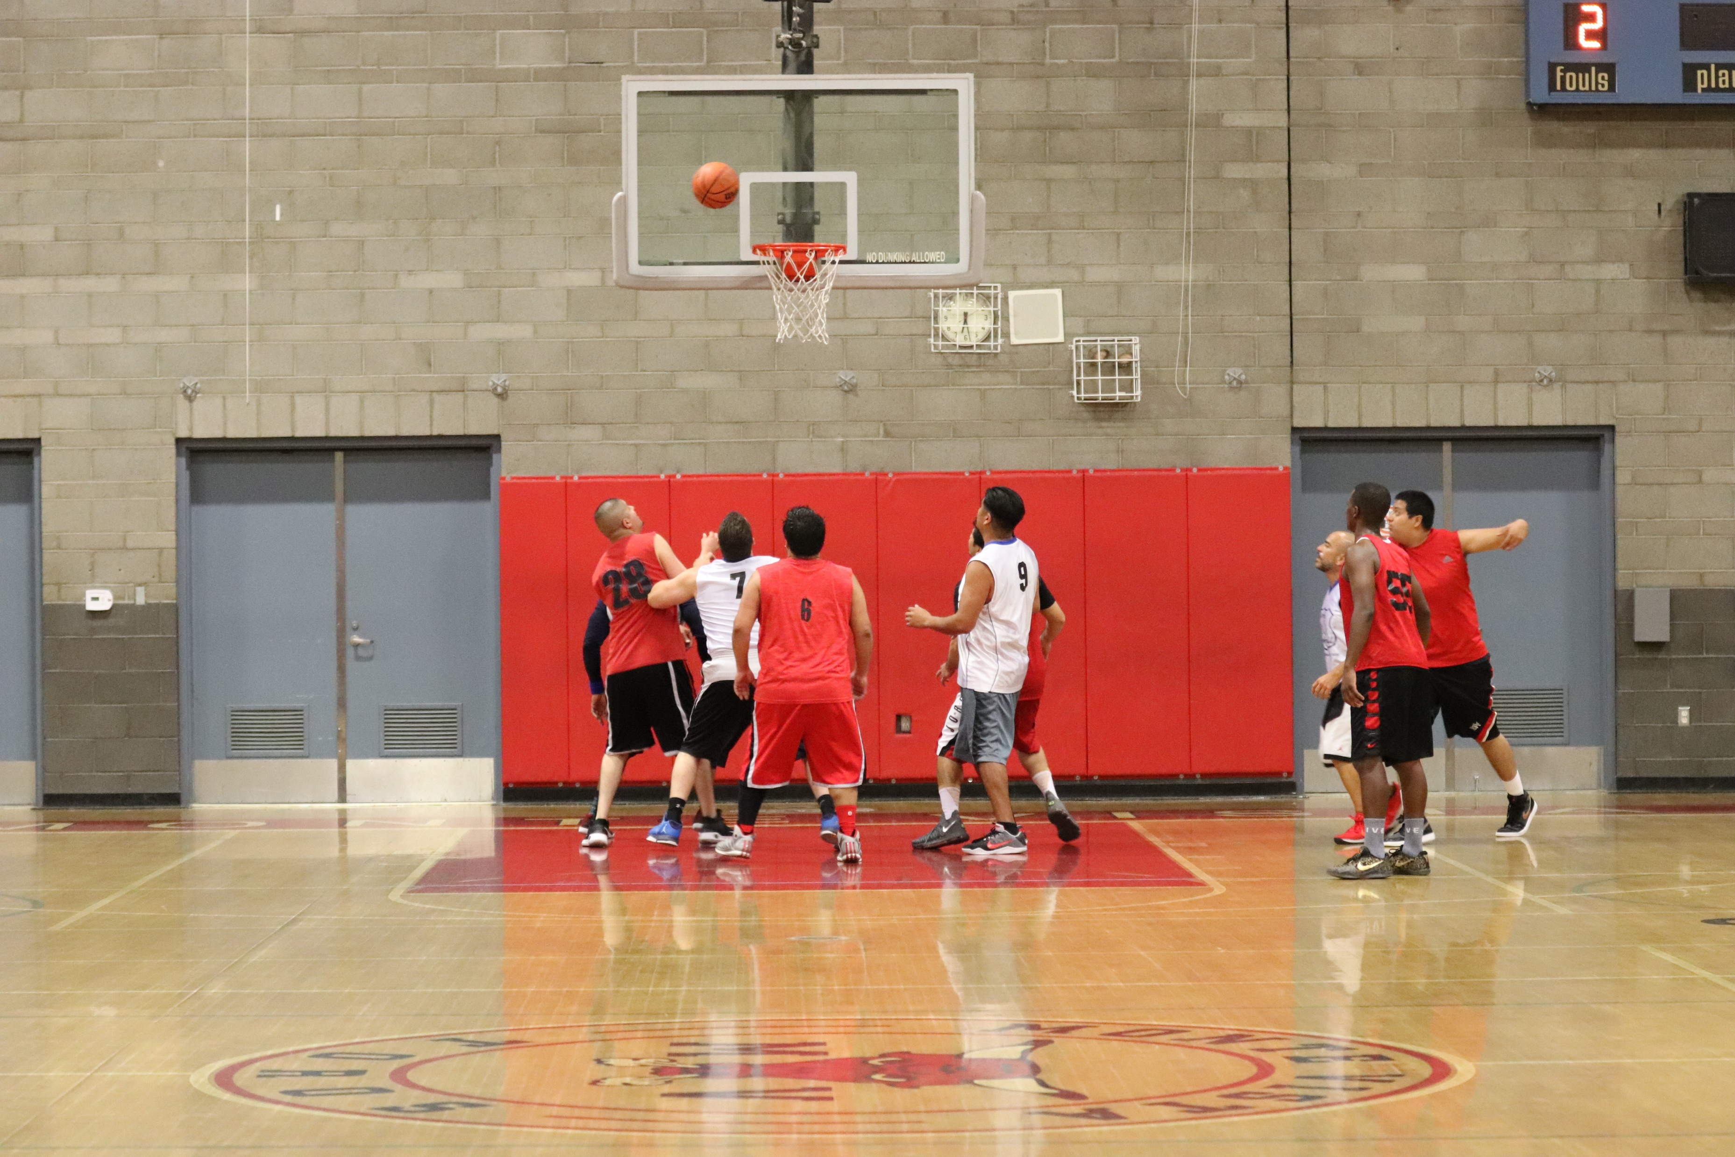
League Play
Men’s C- Monday at Monte Vista
Men’s C- Tuesday at Monte Vista
Men’s C Wednesday at Monte Vista

Slide 4
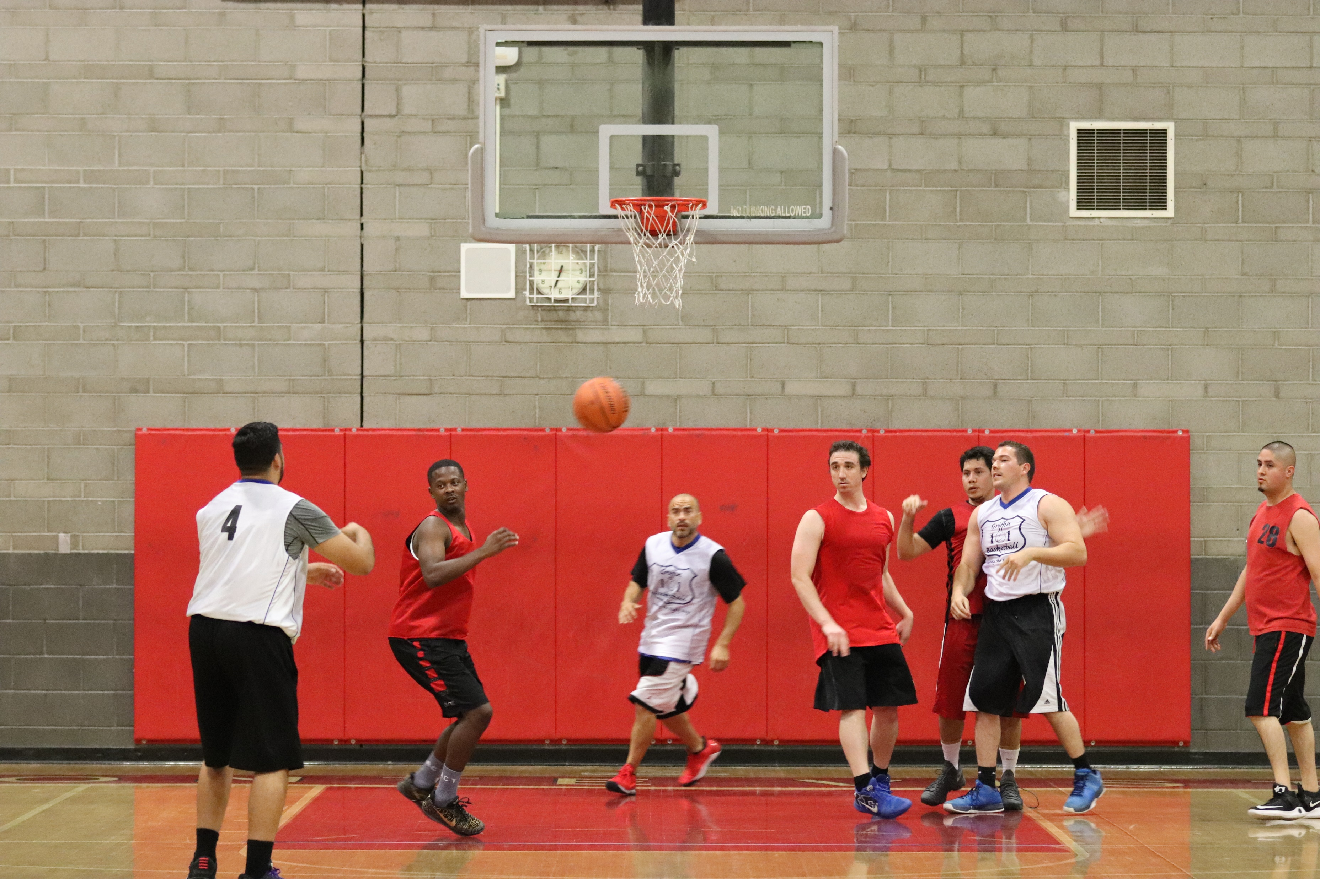
Forfeited Games
Teams failing to field a legal team by game time will be subject to a $60 forfeit fee.
Managers must notify the sports supervisor before 5:00 PM the day prior to the official game time to avoid the $60 forfeit fee. Notification must be made on Friday by 5:00 PM for Sunday games.
Forfeit Fees are due and payable prior to your next scheduled game.
Teams may not play until all forfeit fees are paid.
Credit Cards are now kept on file as a courtesy to pay forfeit fees when you are not available to drive to the District Office. There is a $5 forfeit service fee.

Slide 5
Monday
March 21, 2022
6pm
Shaq O’Neal
LeBron James
Michael Jordan
Anthony Davis
Magic Johnson
Steph Curry
Karl Malone
Kevin Durant
Larry Bird
James Harden
John Stockton
Spike Lee
Jack Nicholson
All scoresheets must have first and last names. Do not put down nicknames.
If a player is late going to be late to the game, add them to the scoresheet before the game.
** Referees may cross-reference Amelia registration list and/or names on scorecard with Driver’s License (or other valid ID) to determine player eligibility

Slide 6
Rules and Regulations
    Officials fees are to be paid (in cash) prior to the game
    Shirts of similar color with numerals are required of all players of a team.
    Numbers must be placed on the front and back of each shirt. The number must be attached permanently to the shirts. Numbers held in place with tape or made of tape are not permitted. Managers must declare their team color on the roster form.”
    Dunking is not permitted at any time. A technical foul and ejection from the game will be the penalty for the violator. This includes any intentional contact with the rim. The rim does not have to be grabbed to be deemed contact.”
    Protests must be lodged at the time of the incident. Tell official immediately of your desire to protest the game. Rule interpretations only. No judgment calls.
    Monday-Wednesday games are at 6:00, 7:00, 8:00 and 9:00pm.
    Always check your schedules. When you receive and during the course of the season
    Players must be at least 16 years of age
    Players ejected from a game must immediately vacate the facility and facility grounds. Otherwise the game will be declared a forfeit by the referee.
    Two twenty-minute halves running clock. *The last two minutes of the second half will be played with a stopped clock if the teams point totals are within 10 points of each other.
    Players may not drink alcohol prior to or during the game. Alcohol may not be brought onto Monte Vista grounds. Tobacco is also not allowed on school grounds.
    Exposed jewelry is not allowed.
    Questioning the legality of a player must be done before or during the game.
    Everything I covered is in the handbook. Read through the handbook before you register your team. Review the “Code of Conduct” with all your players at team meeting, or sometime before your first game

Slide 7

Registering Through Amilia
Amilia is our new reservation system that you’ll use to register your team!
After getting over the learning curve, Amilia will make registering teams more convenient for both you guys and us!

Slide 8
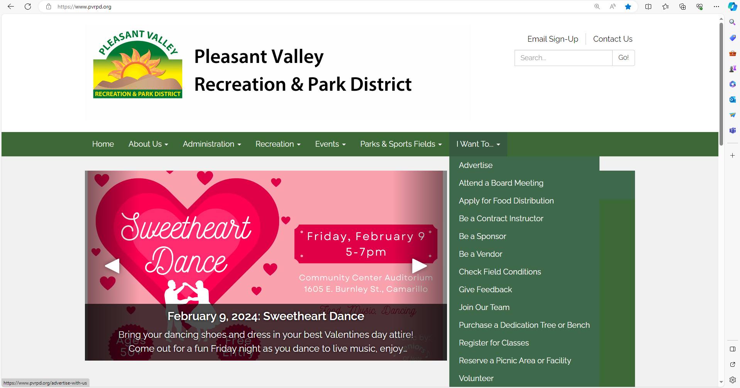
Log on to our main website (www.pvrpd.org), and click on “Register for Classes” on the front page

Slide 9
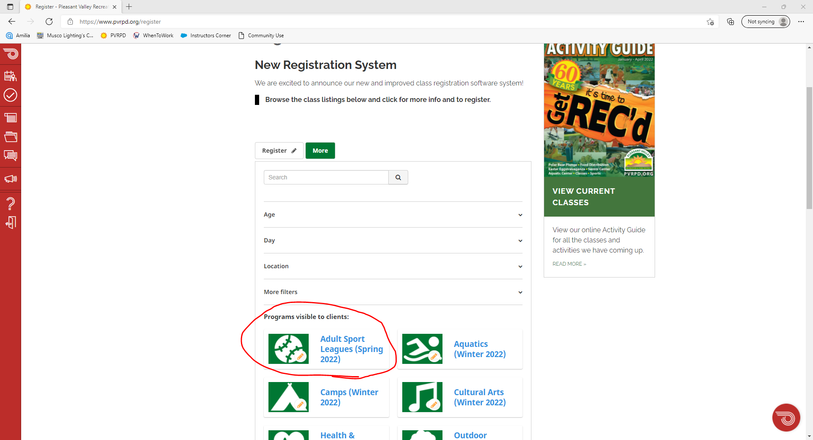
Click on “Adult Sport Leagues”

Slide 10
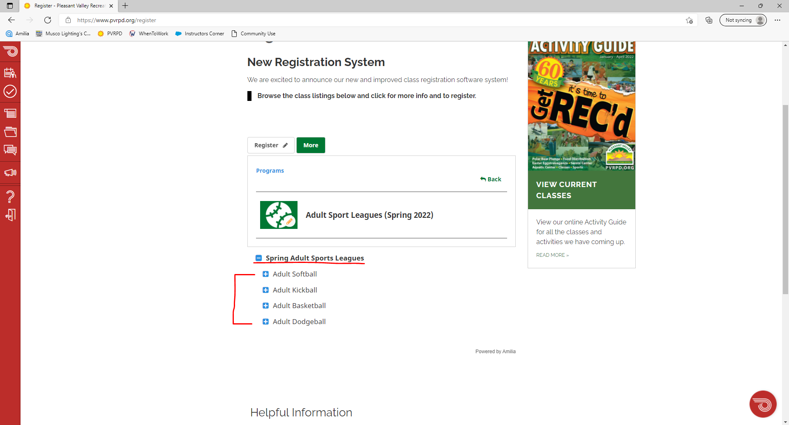
Find the right Adult Sports League season and choose your sport

Slide 11
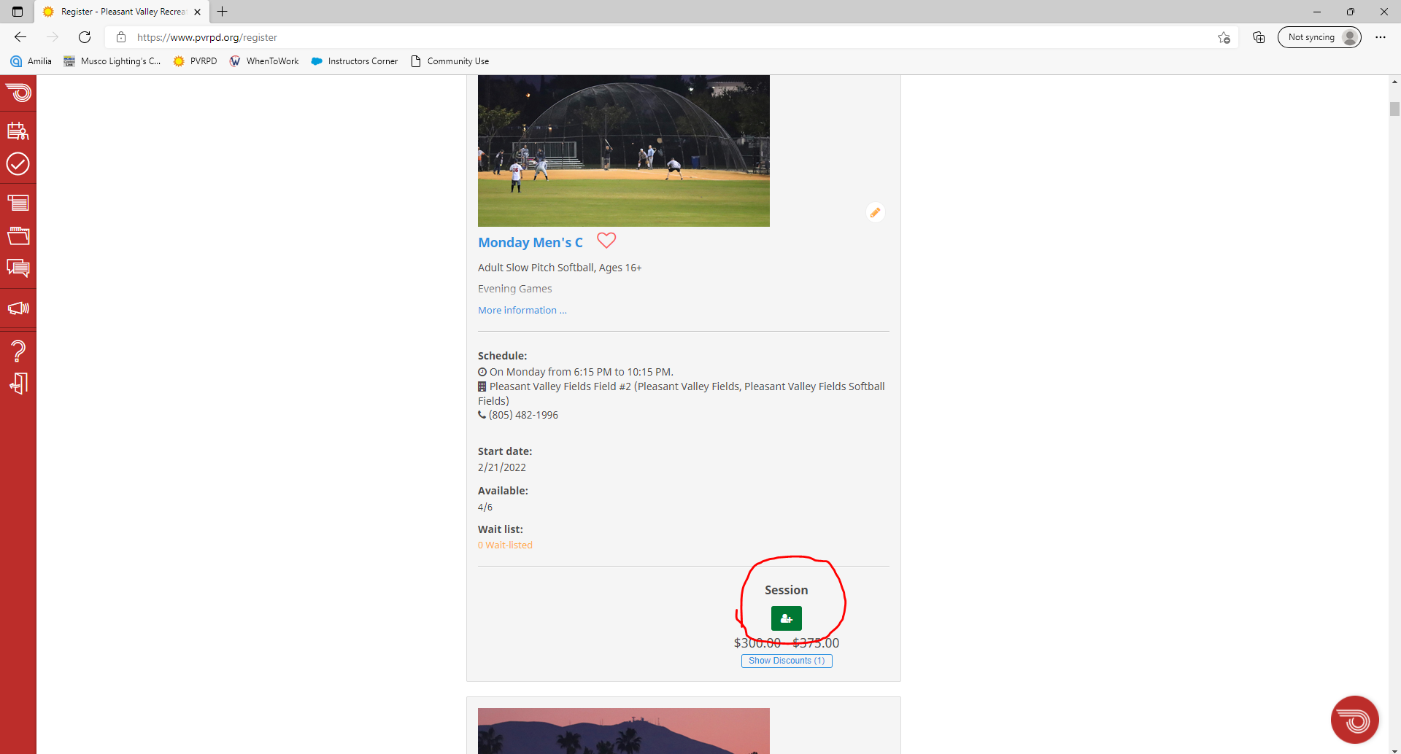
Find the league/night you want to register for and click the green button.

Slide 12
At this point you, will be asked to create an Amilia account if you haven’t already, and then you’ll continue.

Slide 13
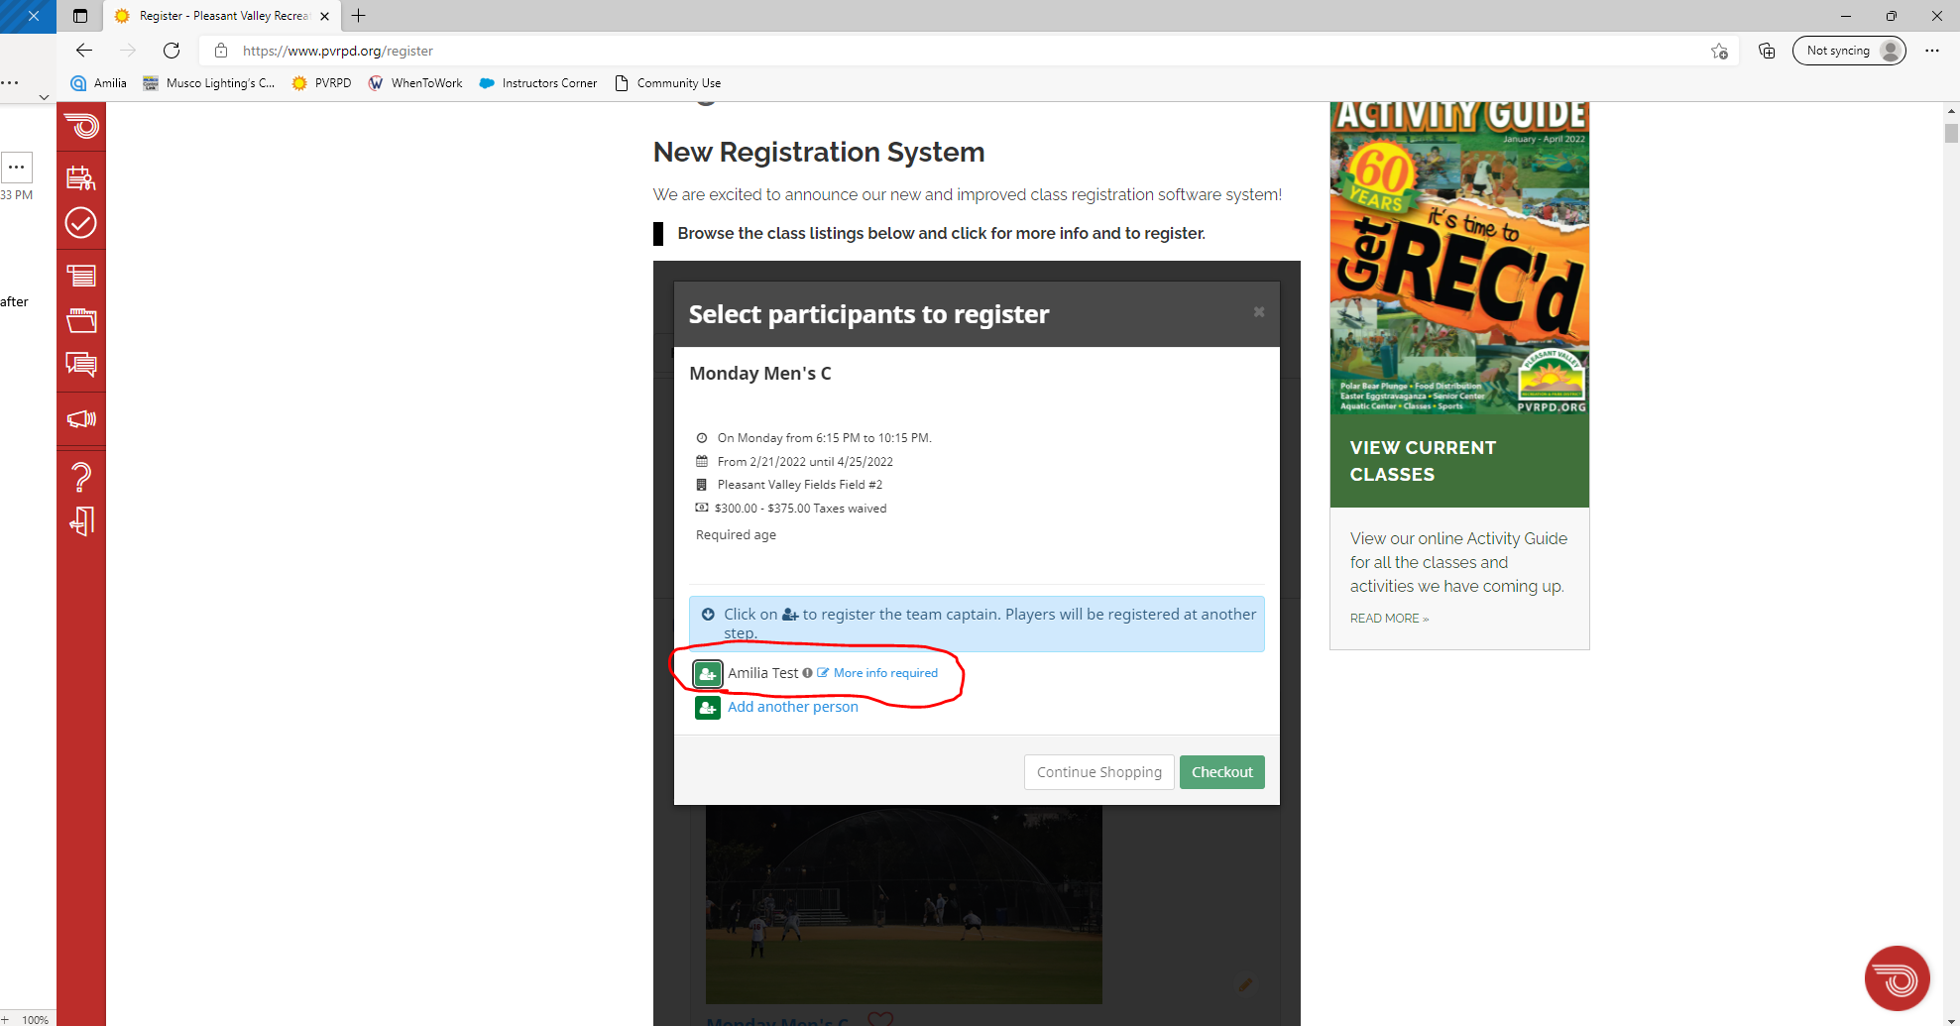
After creating an account, your name should show up here next to the green button where “Amilia Test” is (this is our test account; it will not say Amilia Test for you).

Slide 14
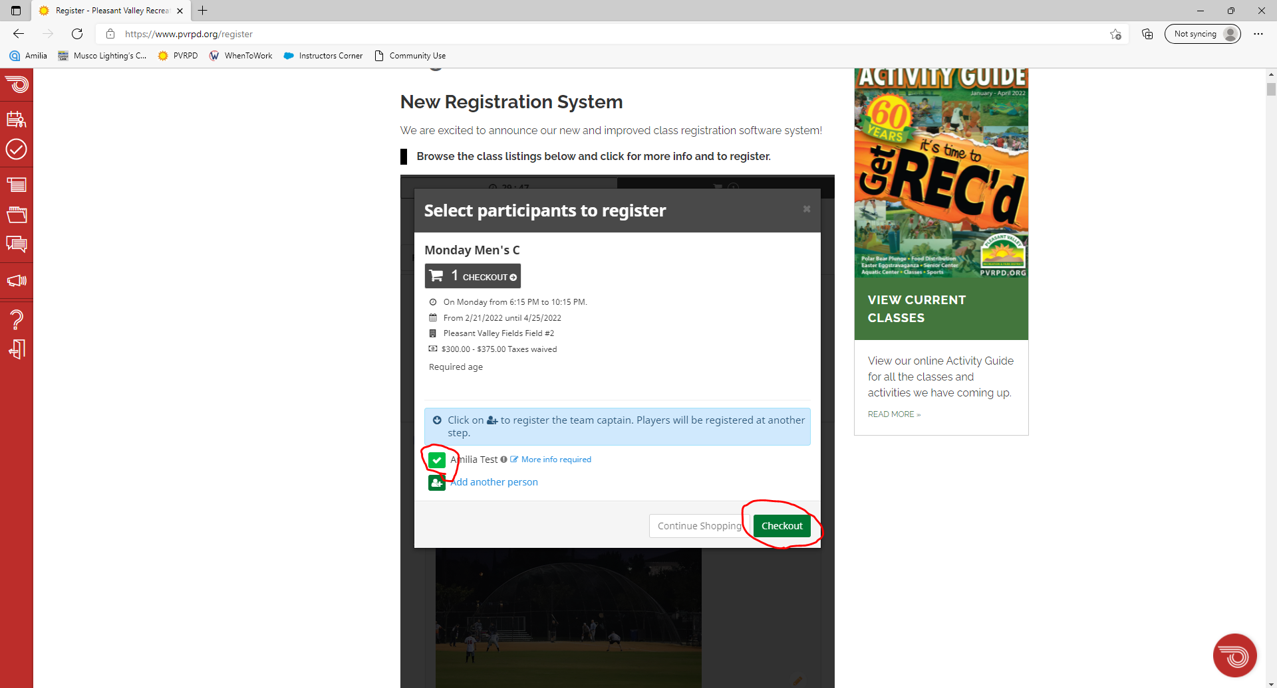
Click the green button next to YOUR NAME ONLY to make it a white check mark. Even though the button beneath it says “add another person”, this is NOT where you add your teammates. Click checkout and continue.

Slide 15
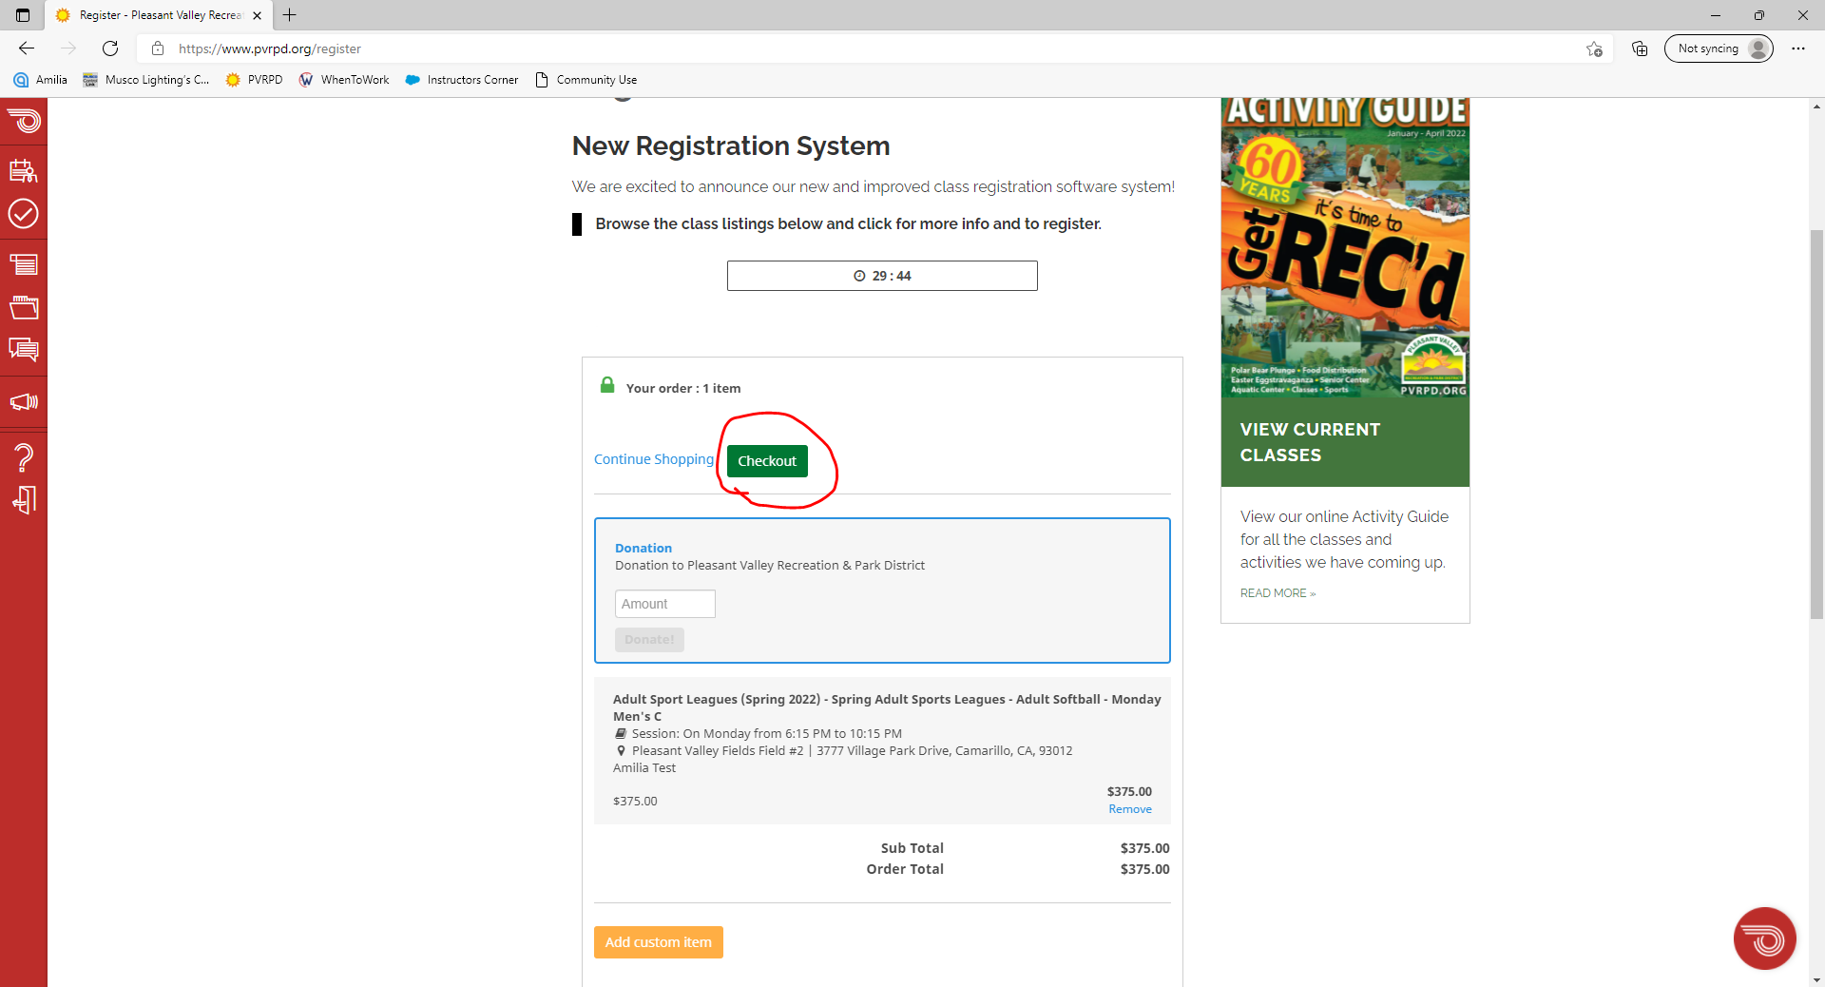
Make sure the price is correct and click checkout again

Slide 16
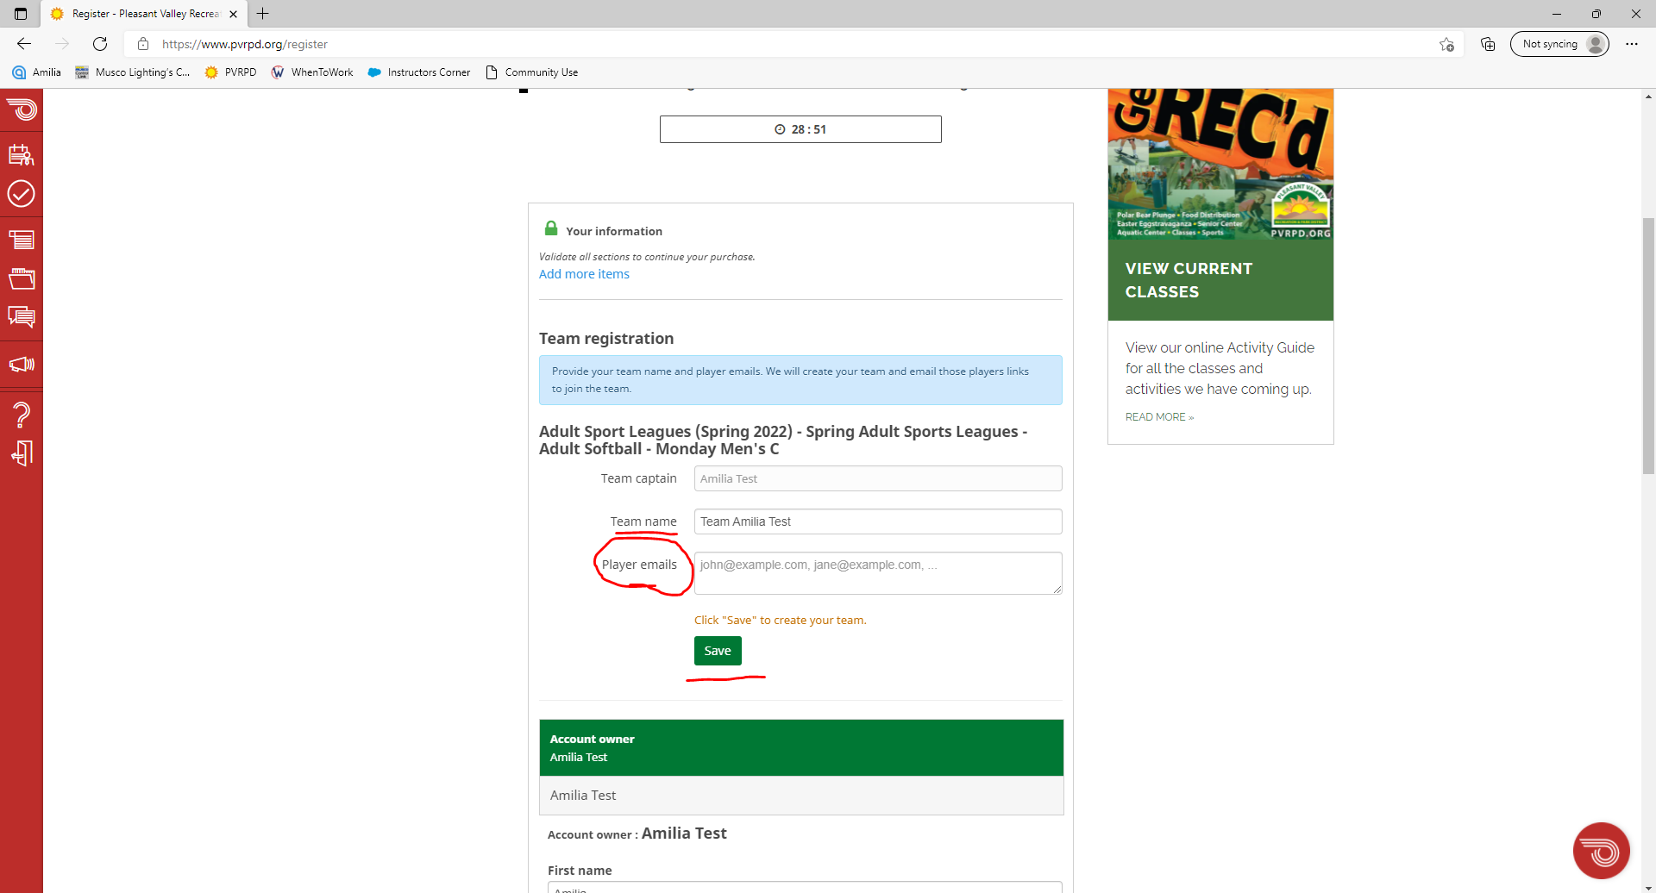
Give yourself a team name.
IMPORTANT – Here is where you’ll add your teammates. In the box next to “Player emails”, list each players email address. Once this has been done, Amilia will send a registration link to their email. This is how they will join your team. Click save.

Slide 17
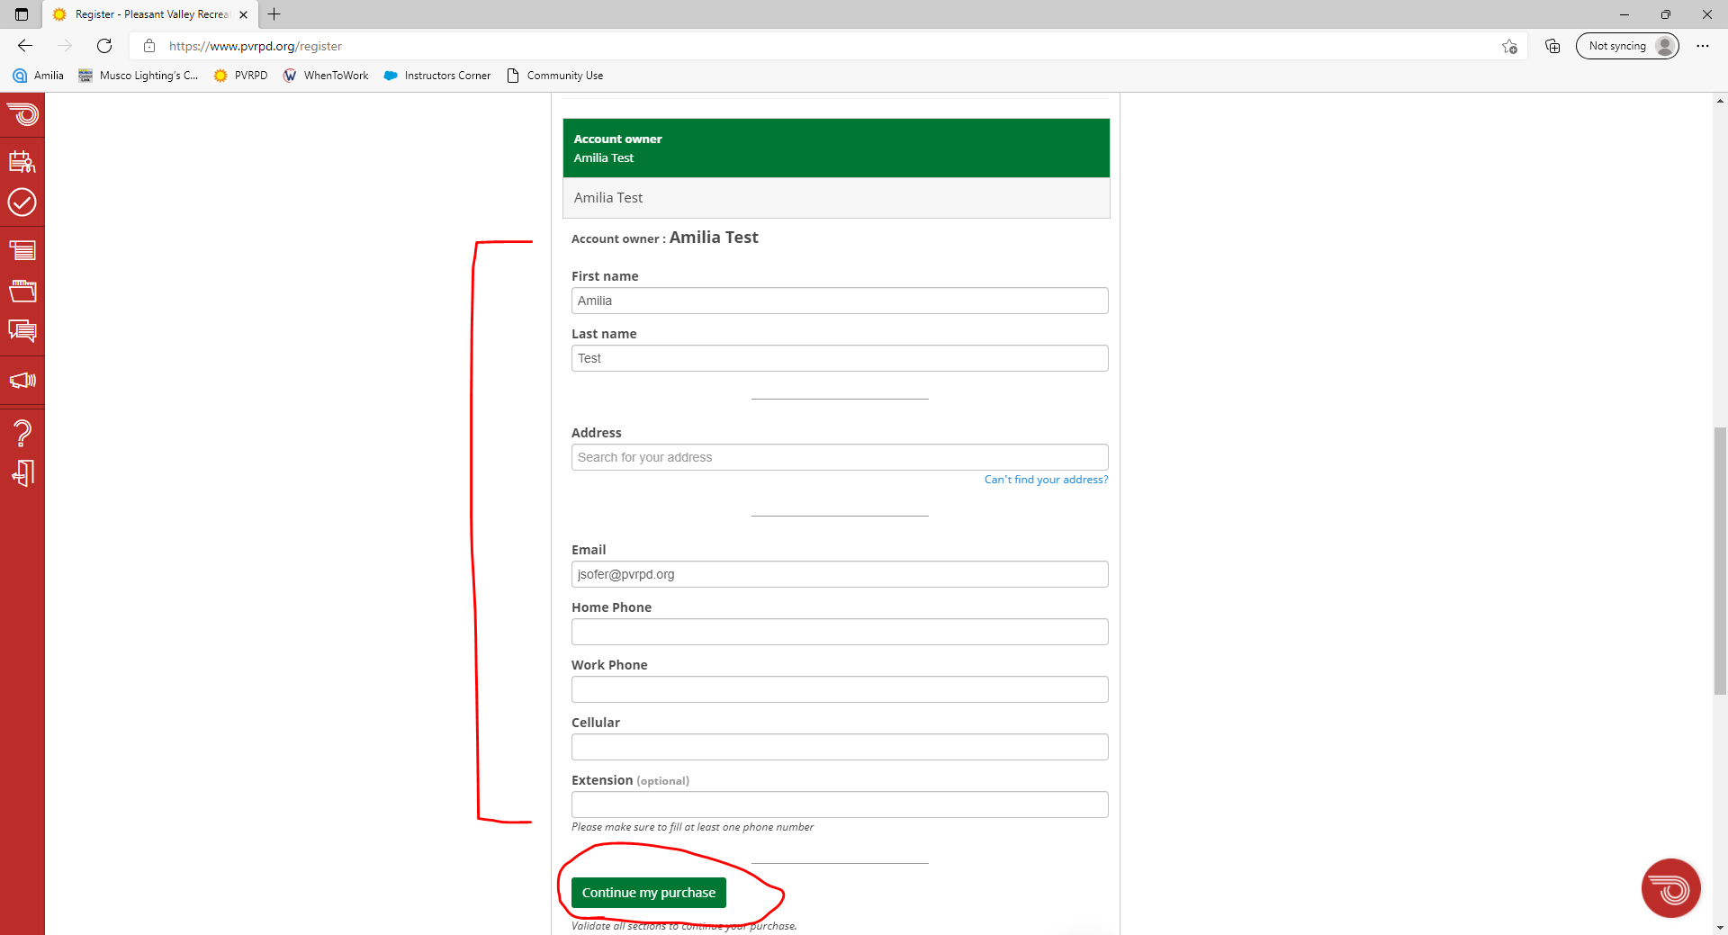
Scroll down the page, fill out a little more personal information, and then click “continue my purchase”.
After this, you’ll be taken to fill out your payment information.

Slide 18
Questions about the league?

