Slide 1

Pleasant Valley Recreation and Park District
2024 Adult Softball Managers Presentation
Macy Trueblood, Recreation Supervisor
Nic Castro, Recreation Specialist

Slide 2
Summer 2024 Registration Dates & Fees (10 weeks)
League Play Begins: Monday, June 3rd
Early Registration: Monday, April 29th - Friday, May 17th
Registration Fee: $395 per team
Late Registration: Saturday, May 18th – Wednesday, May 22nd
Late Registration Fee: $420 per team
Umpire Fee: $20 per team per game
Schedules, Standings & Free Agency located at www.pvrpd.org/softball
Team Managers Register At:
ONLINE - Register - Pleasant Valley Recreation & Park District (pvrpd.org)

Slide 3
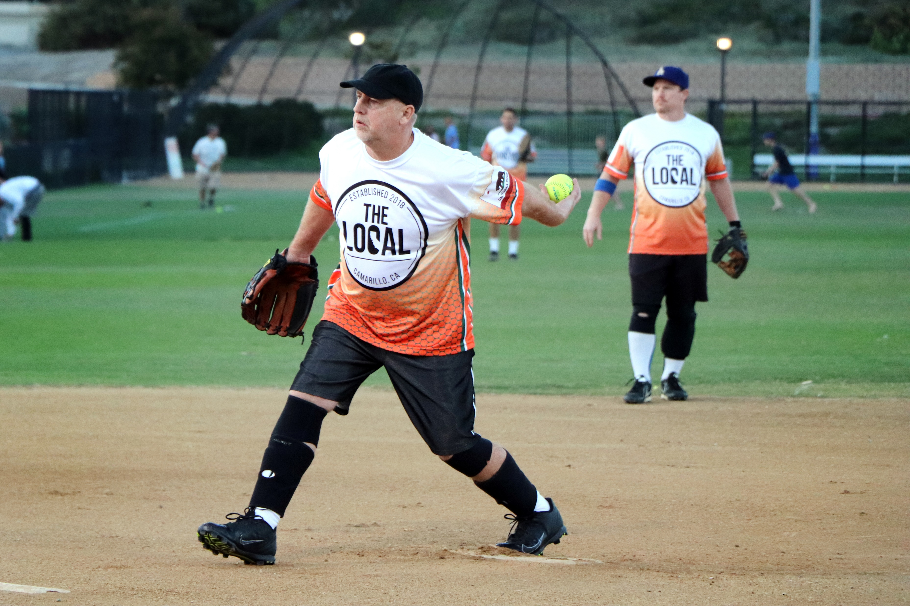
League Play
Men’s Leagues
Monday, Wednesday and Thursday nights located at Pleasant Valley Fields
Co-Ed Leagues
Friday and Sunday at Mission Oaks Fields

Slide 4
Player Add/Drops
Player additions and drops can be done online through Amilia. Any Add/Drop notice received after 4:00 PM will be considered effective the following business day.
No additions or drops will be allowed after 4:00 p.m. the day of your team’s fourth scheduled league week* except:
When roster falls below 12 players (6 men and/or 6 women for Co-Ed) and then for the remainder of the season the team roster should not exceed 12 players.
All player Add/ Drops can be done on Amilia.
No additions will be made for Playoff games.

Slide 5
Holidays and Special Events
No games on Valentine’s Day, Easter, Halloween, or Thanksgiving. We may schedule games if needed around the 4th of July.
  Because of other groups using our parks, rain outs, etc. games may be scheduled on:
  Good Friday,
  Mother’s Day,
  Memorial Day weekend,
  Father’s Day weekend,
  Labor Day weekend
  Columbus Day,
  Veteran’s Day
  Please note that time changes for Daylight-Savings starts Sunday, March 10th and Daylight-Saving Ends Sunday, November 3rd.

Slide 6
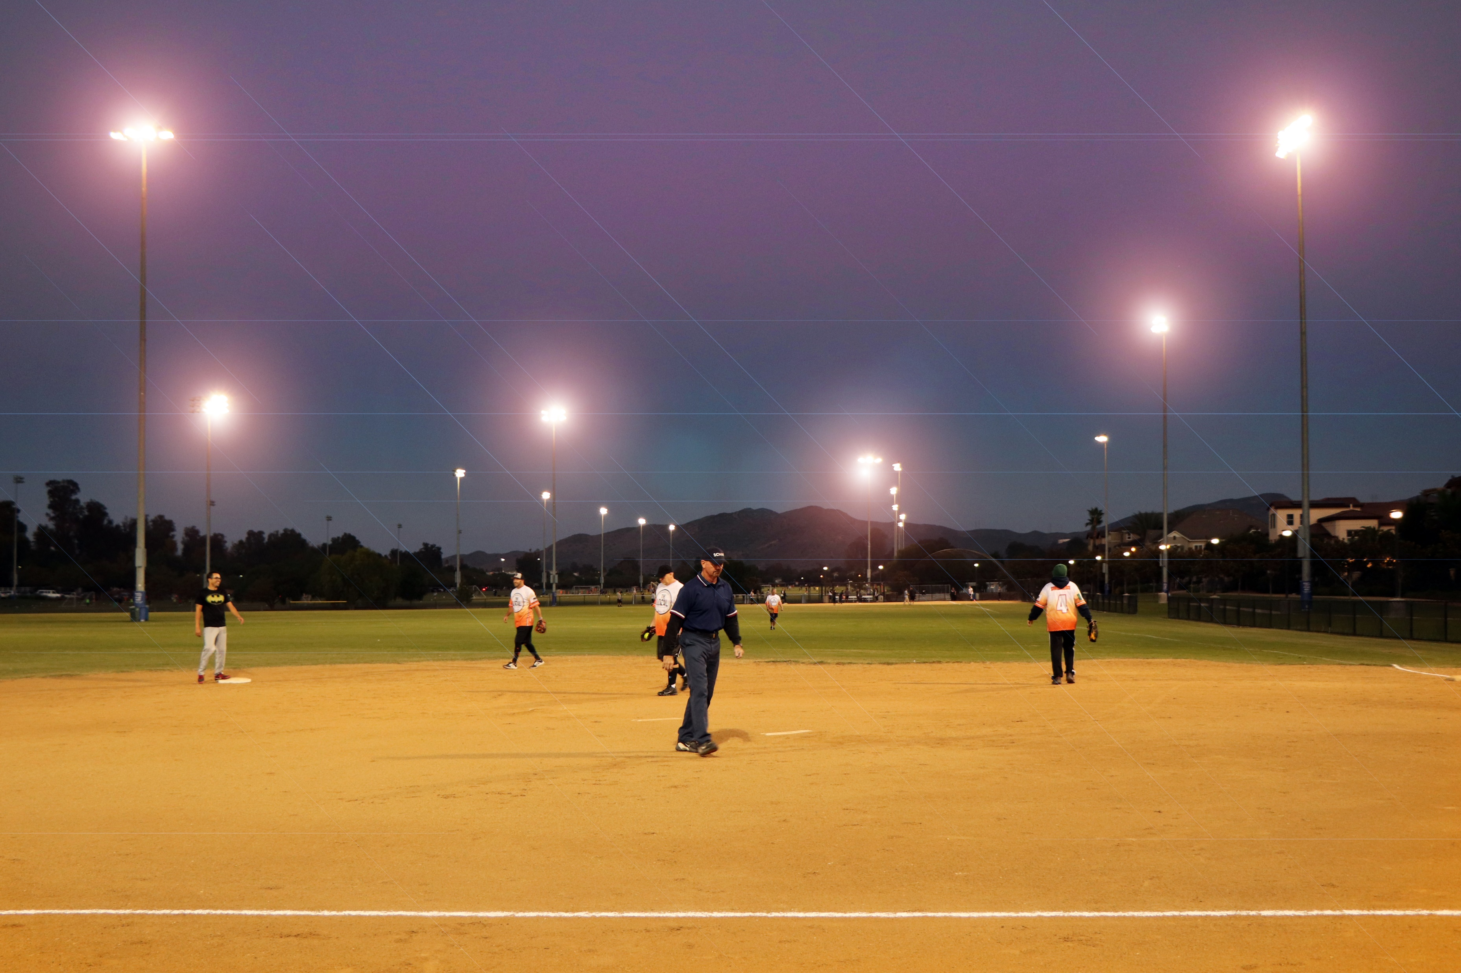
Forfeited Games
Teams failing to field a legal team by game time will be subject to a $40 forfeit fee.
Managers must notify the sports supervisor before 5:00 PM the day prior to the official game time to avoid the $40 forfeit fee. Notification must be made on Friday by 5:00 PM for Sunday games.
Forfeit Fees are due and payable prior to your next scheduled game. Teams may not play until all forfeit fees are paid.
Credit Cards are taken to pay forfeit fees when you are not available to drive to the District Office. There is a $5 service fee when paying by credit card.

Slide 7
Joe’s Auto Shop
Jose Altuve
J.D. Martinez
Mike Trout
Buster Posey
Justin Turner
Clayton Bellinger
Mookie Betts
Paul Goldschmidt
Hot Dogs & Buns
Aaron Judge
Manny Machado
Anthony Rizzo
Kate Beckinsale
Jessica Mendoza
2/20/22
6pm
Sun Coed C
MO 1
Natasha Watley
Carmen Electra
Crystal Bustos
Lisa Fernandez
All scorecards must have first and last names.
Do not put down nicknames.
In Coed leagues, men and women alternate in the batting order.
If a player is late to the game, add them at the end of the batting order.
At any time before or during play, Umpires may request photo ID for identification and verification of any player’s status on the roster.
Dot Richardson
Jenny Finch
Cat Osterman
Diane Lane
Gabrielle Reece

Slide 8
Rules and Regulations
Certified Bat List
Blue/White scorecards must be complete and returned to umpire prior to game time
Umpire fees are to be paid in cash prior to game time.
Umpires will keep the official score and game time.
Protests must be made before the next pitch. Tell the umpire immediately of your desire to protest the ruling. Protests may only be filed on rule interpretations only. No judgment calls. Seek out our field monitor on duty and have them give you a protest form. Have the umpire complete the form on the back (batter, outs, who is on base, etc.) Protest forms and a $10 protest fee must be submitted to the District Office by 5:00 pm the next business day.
Players must be at least 16 years of age to play. All players under the age of 18 must have a parent sign the Parent Authorization Form found on PVRPD website.
Sliding is not mandatory. If your players decide to slide you must avoid contact with the defensive player.
Players ejected from a game must vacate the park immediately within a five minute period. If not, the game will be declared a forfeit. Players ejected in game 1 of a double header will automatically be suspended for game 2.
New managers are encouraged to read the Softball Manager’s Handbook before your first game.
Games will not be rescheduled if cancelled. Rainouts or other postponements set by the Park District will be played at the end of the season.
Staff are only as powerful as the handbook, so please, please, read the handbook!

Slide 9

Registering Through Amilia
Amilia is our new reservation system that you’ll use to register your team!
After getting over the learning curve, Amilia will make registering teams more convenient for both you guys and us!

Slide 10
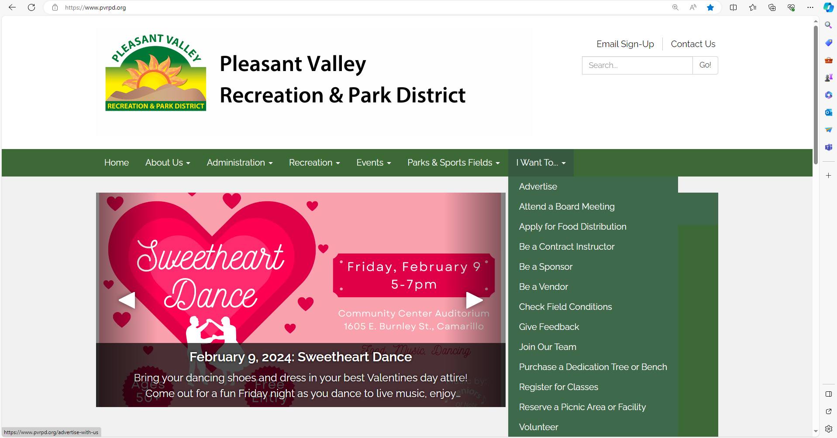
Log on to our main website (www.pvrpd.org), and click on “Register for Classes” on the front page

Slide 11
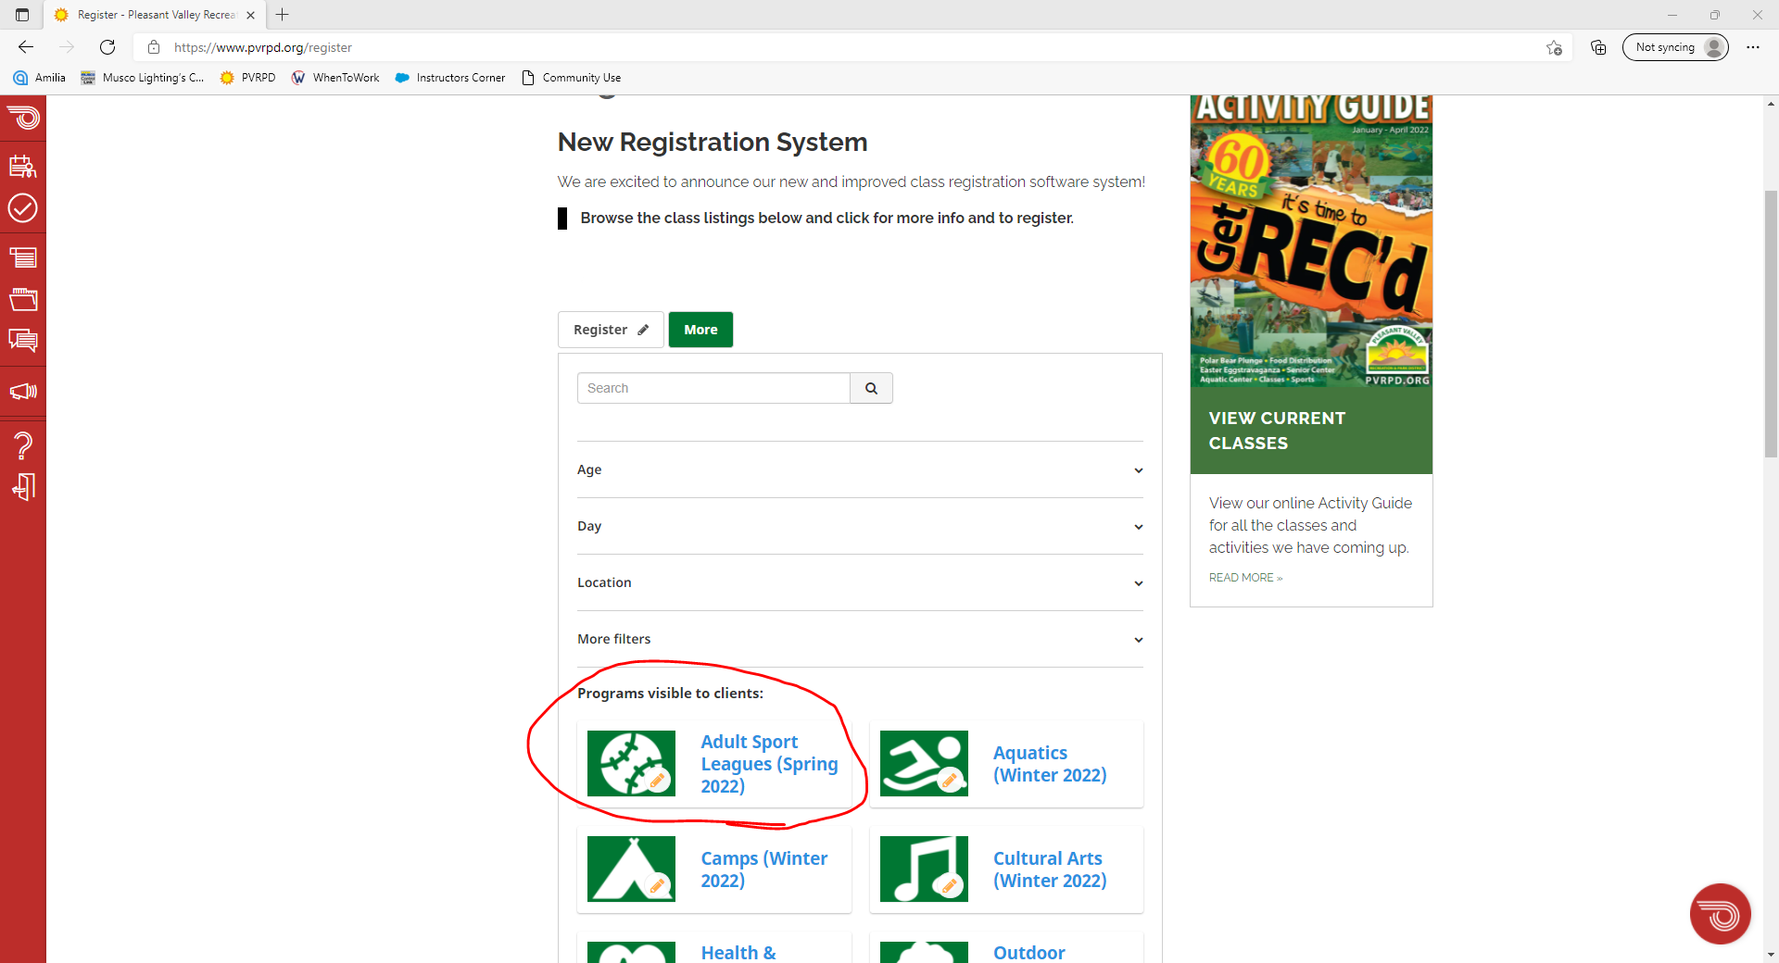
Click on “Adult Sport Leagues”

Slide 12
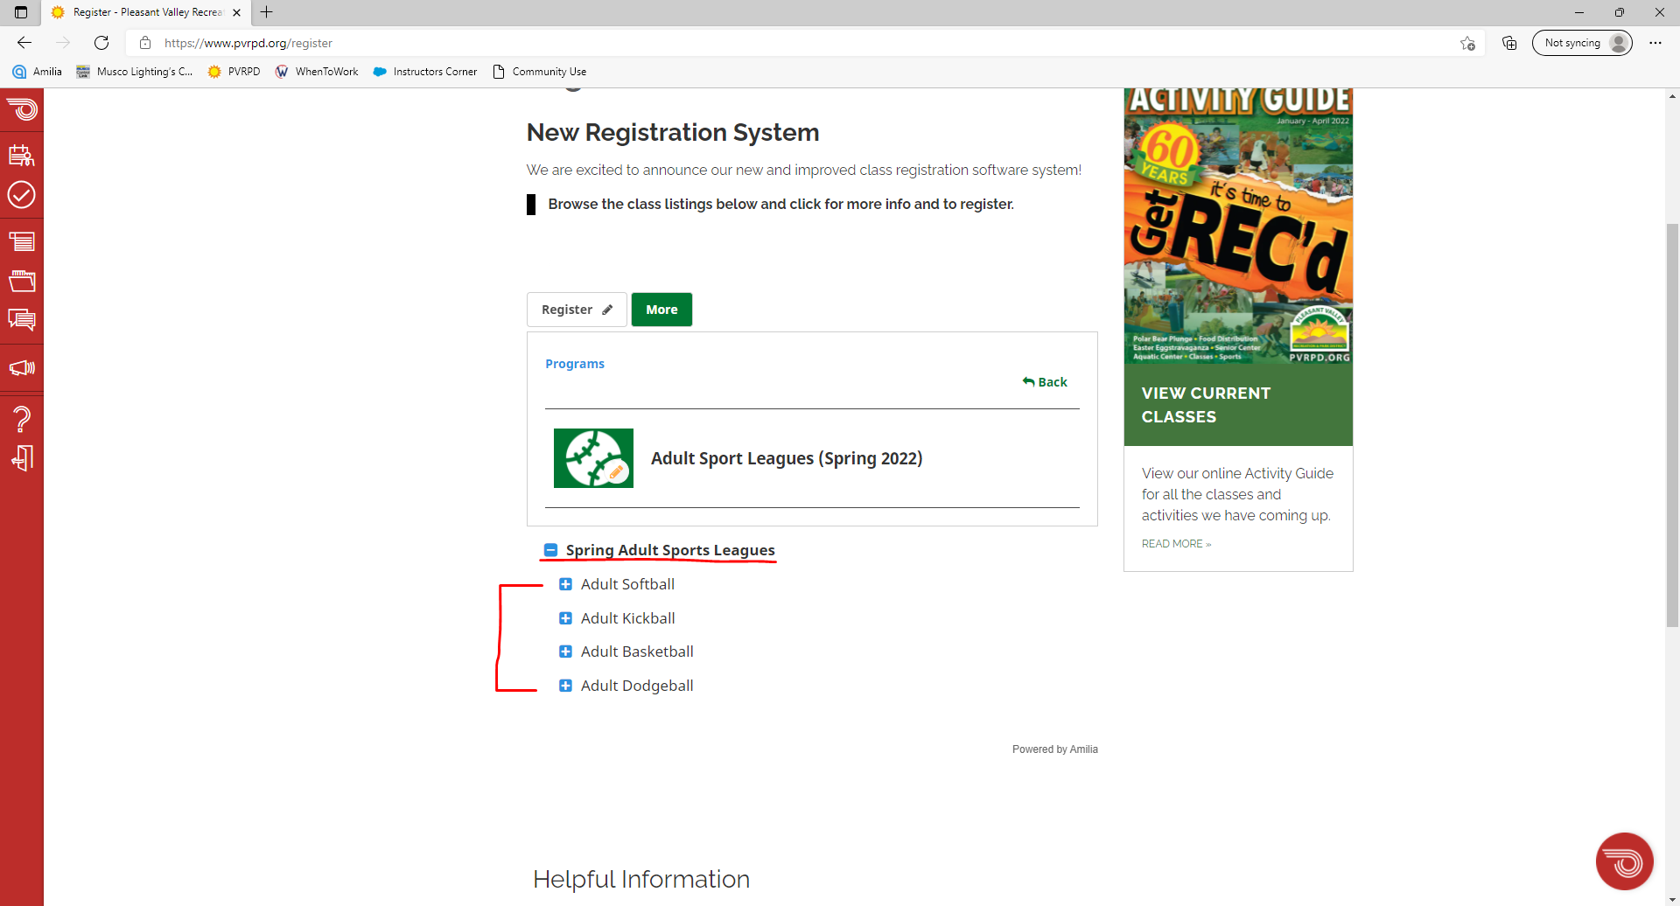
Find the right Adult Sports League season and choose your sport

Slide 13
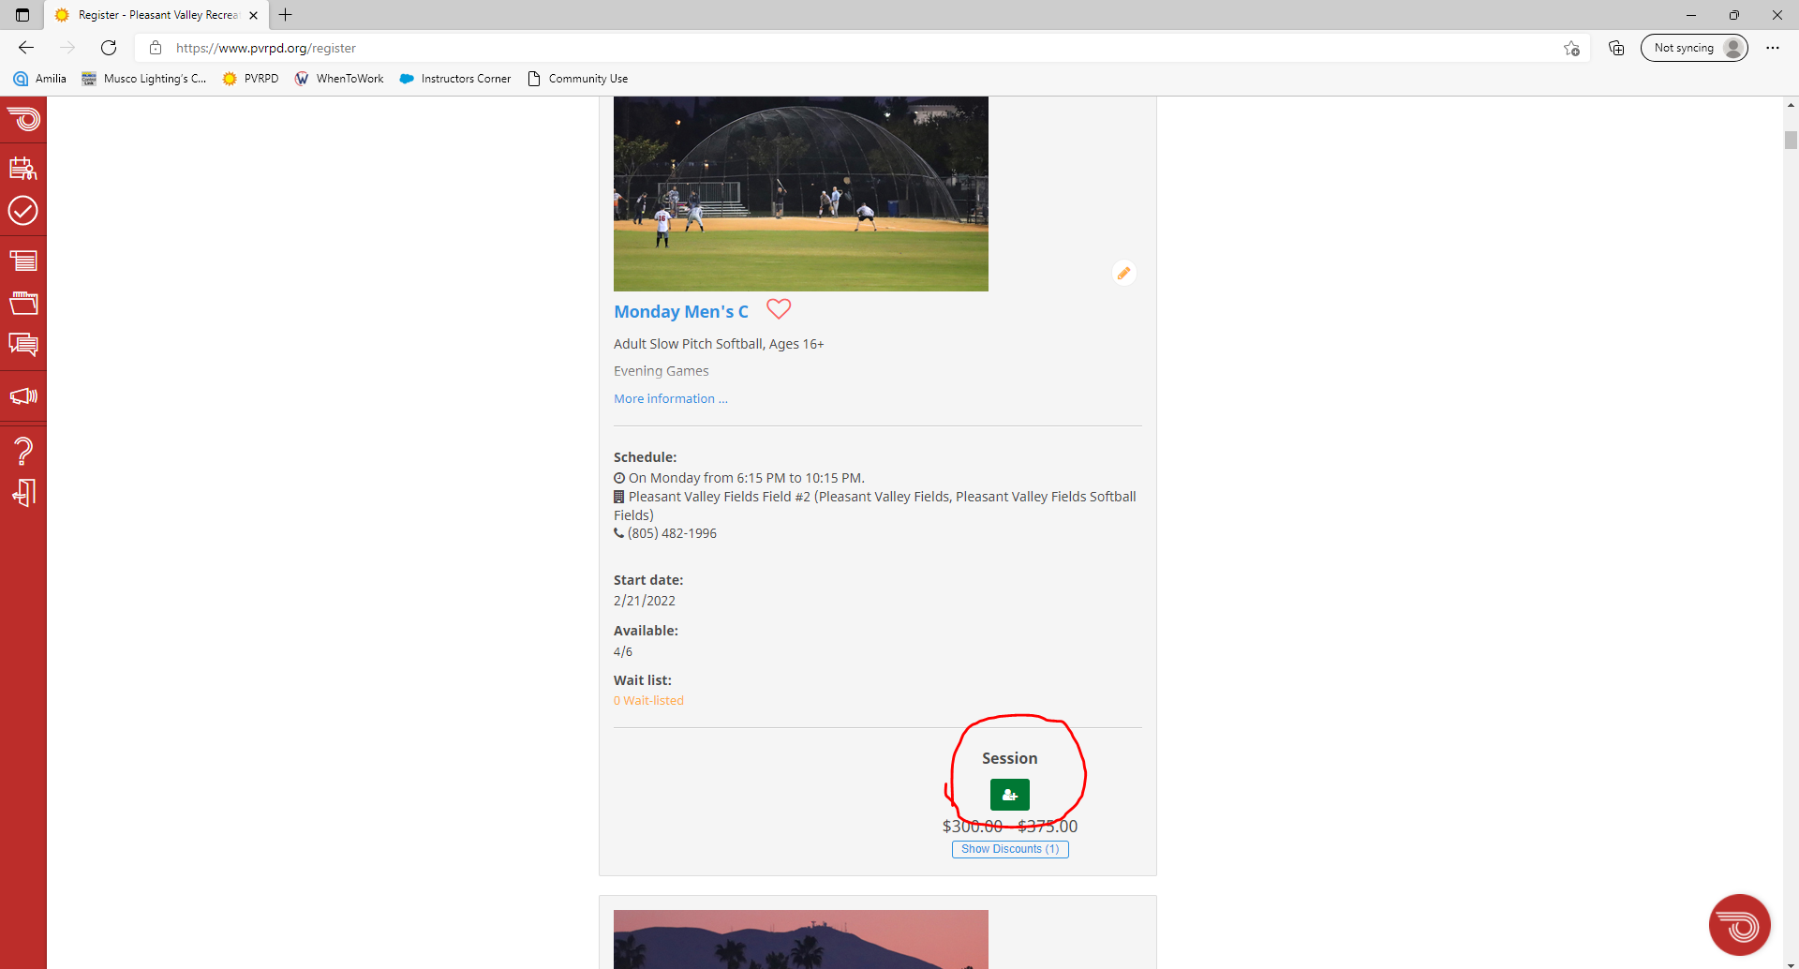
Find the league/night you want to register for and click the green button.

Slide 14
At this point you, will be asked to create an Amilia account if you haven’t already, and then you’ll continue.

Slide 15
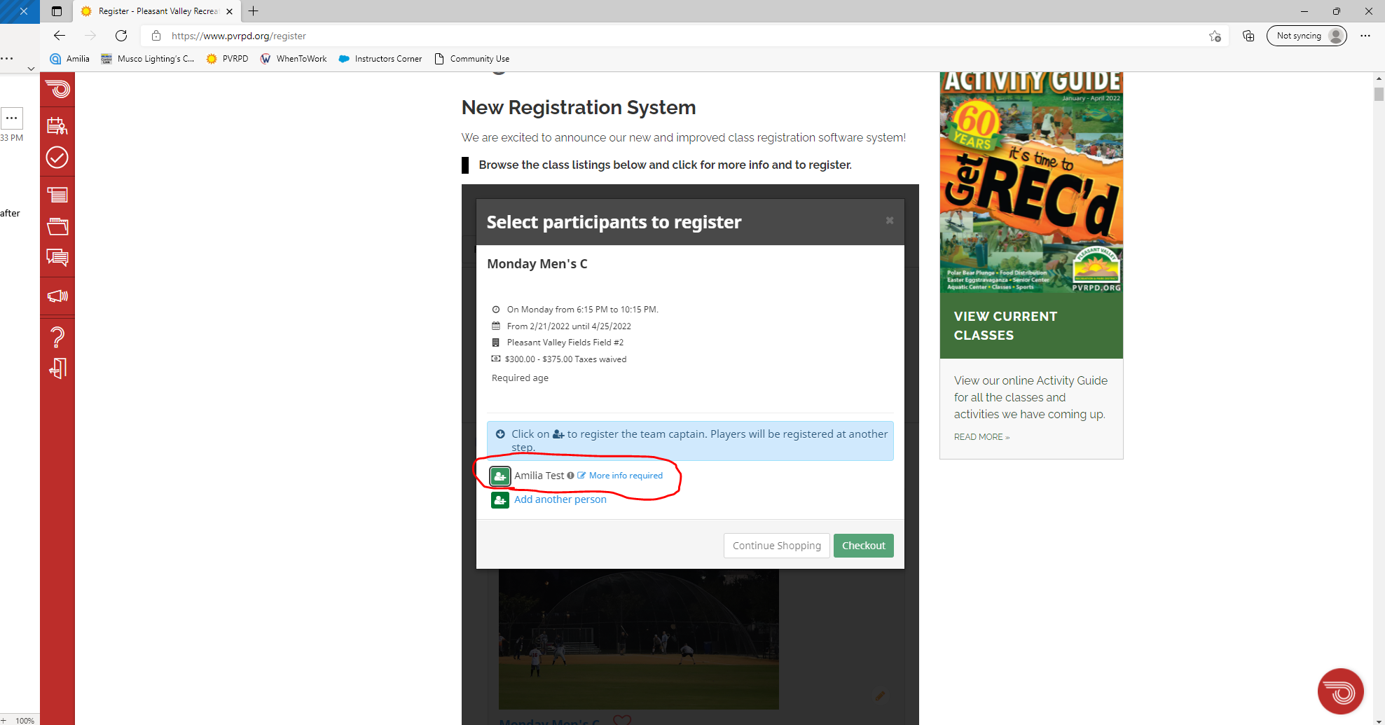
After creating an account, your name should show up here next to the green button where “Amilia Test” is (this is our test account; it will not say Amilia Test for you).

Slide 16
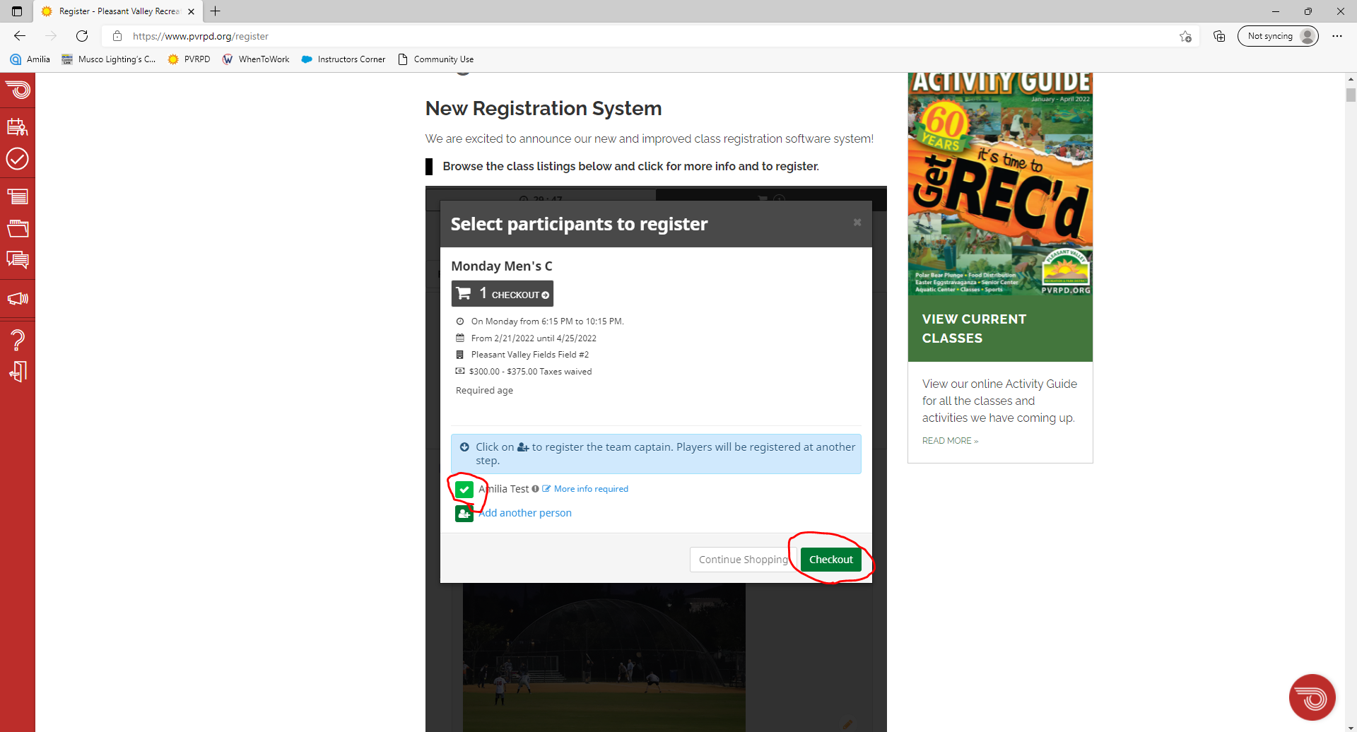
Click the green button next to YOUR NAME ONLY to make it a white check mark. Even though the button beneath it says “add another person”, this is NOT where you add your teammates. Click checkout and continue.

Slide 17
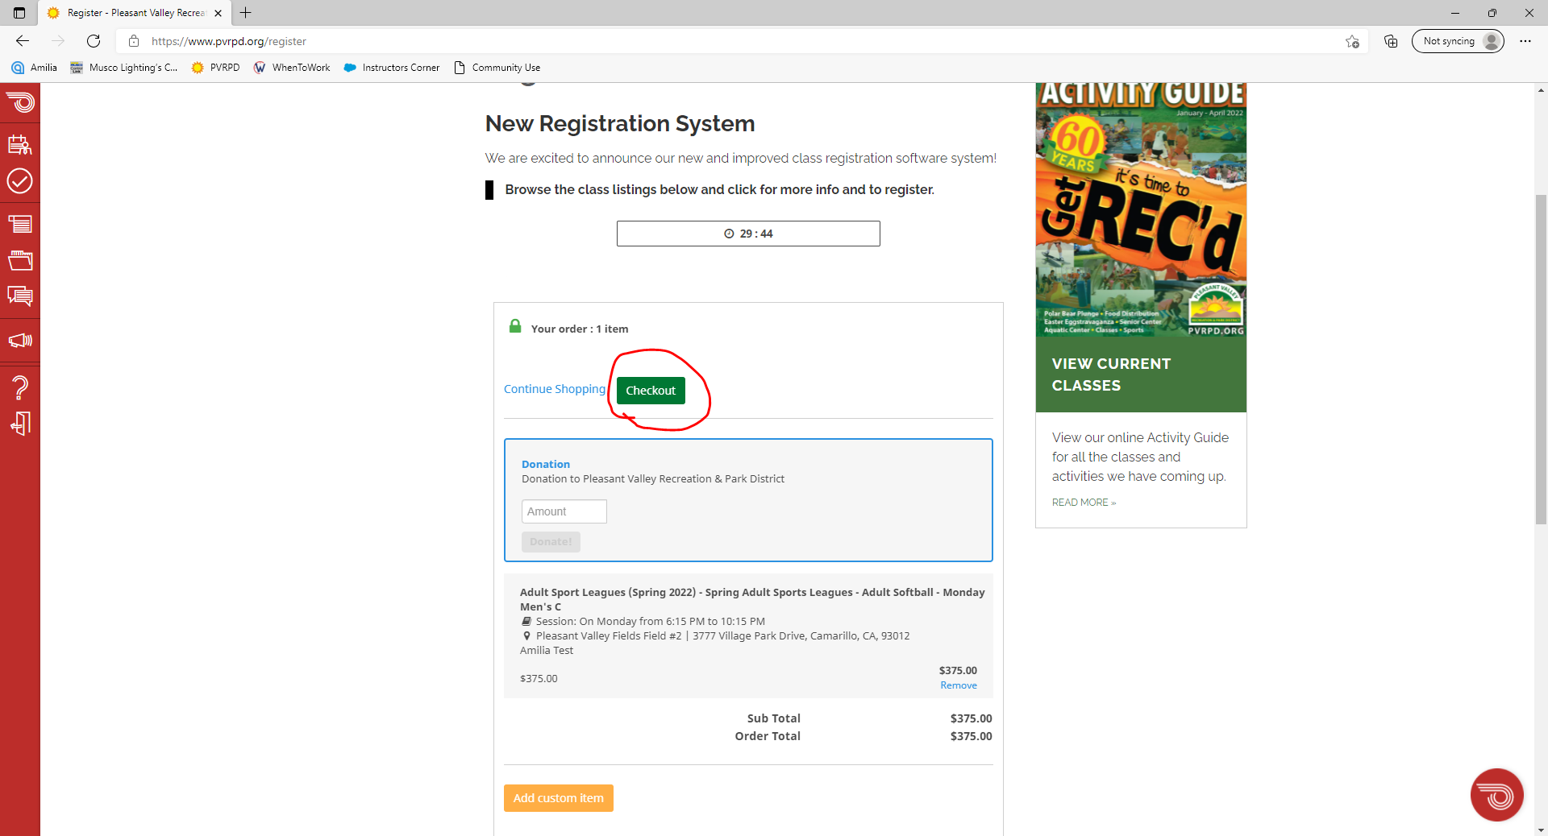
Make sure the price is correct and click checkout again

Slide 18
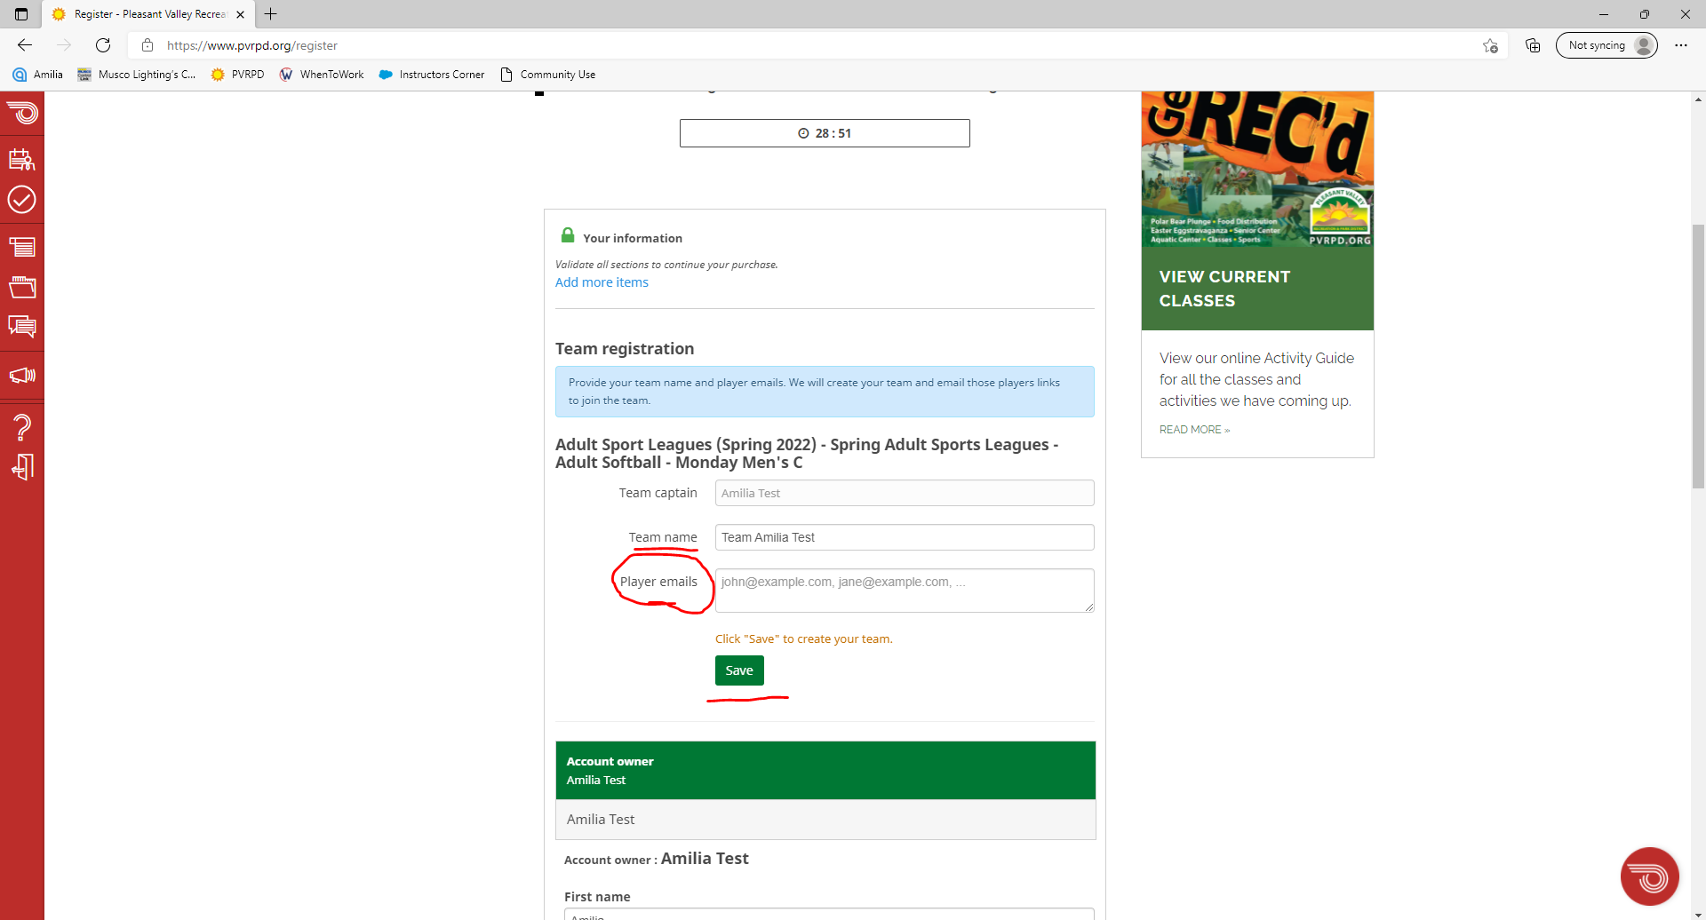
Give yourself a team name.
IMPORTANT – Here is where you’ll add your teammates. In the box next to “Player emails”, list each players email address. Once this has been done, Amilia will send a registration link to their email. This is how they will join your team. Click save.

Slide 19
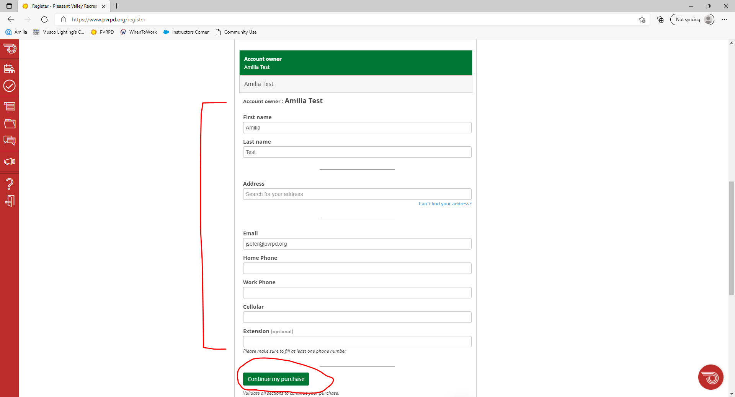
Scroll down the page, fill out a little more personal information, and then click “continue my purchase”.
After this, you’ll be taken to fill out your payment information.

Slide 20
Discussion Items:
Team Sidelines brought back
Awards
  Currently Long sleeve Dry Fits for winning team
  Option: $150 off next season’s registration
End of Season Softball Showdown?
  Winners from each League playoff
  Would not happen until Summer season

Slide 21
Questions/Concerns?
Nicholas Castro
Recreation Specialist
805.482.1996 x403
ncastro@pvrpd.org
Or
Macy Trueblood
Recreation Supervisor
mtrueblood@pvrpd.org
805.482.1996 x401

